Slide 1
本质图像论文汇报（二）
汇报人：方阳

Slide 2
Content
1. Benchmarking Single-Image Reflection Removal Algorithms（ICCV2017）
2. A Joint Intrinsic-Extrinsic Prior Model for Retinex（ICCV2017）
3. Some Results on BOLD datasets and MIT datasets

Slide 3
1. Benchmarking Single-Image Reflection Removal Algorithms

Slide 4
Contributions
Benchmark dataset. The first dataset for the quantitative evaluations of single-image reflection removal algorithms with ground truth for 140 different scenes. The 40 controlled scenes have varying blur levels and glass thickness for evaluating the widely adopted priors in state-of-the-art methods, and the 100 wild scenes.
A brief survey. Provide a concise summary and categorization for reflection removal algorithms according to their input requirements and constraints.
Quantitative and visual quality evaluations. Compare the performance of recent single-image reflection removal algorithms using different error metrics to understand existing problems and inspire future research.

Slide 5
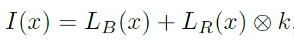
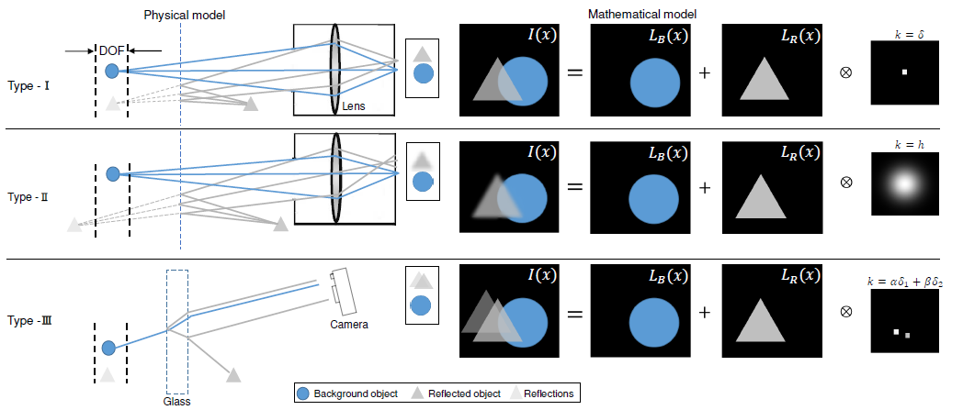
Image Formation Models
Notes:
I(x) is the intensity of light received by camera. LB(x) is the intensity of light from the objects behind the glass
LR(x) is the intensity of light from the scenes reflected off the glass surface. K is a convolution kernel.
For Type-I method, the objects behind the glass and reflections are approximately in the same focal plane.
For Type-II method, the reflections and objects behind the glass have different distances from the camera,
For Type-III method, physics model should also take the thickness of glass into consideration.

Slide 6

$${SIR}^{2} Dateset$$
With ground truth provided: We treat a triplet of images as one set, which contains the mixture image, and the ground truth of background and reflection.
Diverse scenes: Three sub-datasets, the first one contains 20 controlled indoor scenes composed by solid objects; the second one uses postcards to compose another set of 20 different controlled scenes; and the third one contains 100 different wild scenes.
Varying settings for each controlled scene: For each triplet in the controlled scene dataset, we take images with 7 different DoFs (by changing the aperture size and exposure time) plus 3 different thicknesses of glass.
Large size: our dataset contains (20 + 20) ×(7 + 3) × 3 + 100 × 3=1500 images.

Slide 7

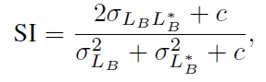
Single-image Reflection Removal Algorithms and Error metrics
Four SOTA Methods: AY07(PAMI2007), LB14(CVPR2014), SK15 (CVPR2015), WS16(ICIP2016)
Error metrics: absolute difference such as MSE and PSNR is too strict since a single incorrectly classified edge can often dominant the error value, so use sLMSE, NCC, SSIM, SI.
Notes:
SSIM definition are sensitive to the intensity variance, SI focus only on the structural similarity

Slide 8
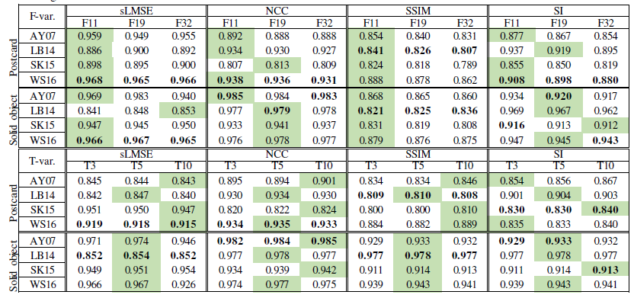
Benchmark results using controlled scene dataset
Notes:
F-var is aperture size variations, T-var is thickness variations.

Slide 9
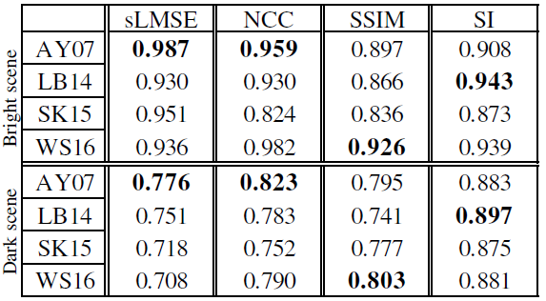
Benchmark results in the wild scene dataset

Slide 10
2. A Joint Intrinsic-Extrinsic Prior Model for Retinex

Slide 11
Method Analysis
Imaging Process: The 2D image formed from 3D object in the scene is affected by the intrinsic properties (shape and texture) and the extrinsic property (illumination).
Propose A Joint Intrinsic-Extrinsic Prior Model For Retinex!

Slide 12
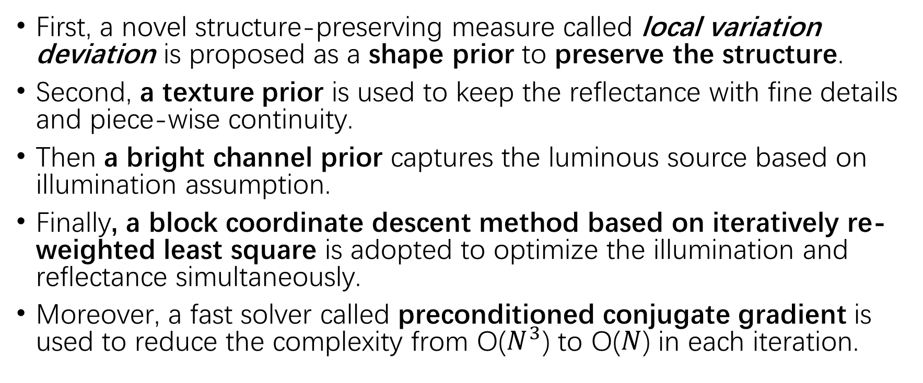
Method Flow
First, a novel structure-preserving measure called local variation deviation is proposed as a shape prior to preserve the structure.
Second, a texture prior is used to keep the reflectance with fine details and piece-wise continuity.
Then a bright channel prior captures the luminous source based on illumination assumption.
Finally, a block coordinate descent method based on iteratively re-weighted least square is adopted to optimize the illumination and reflectance simultaneously.
Moreover, a fast solver called preconditioned conjugate gradient is used to reduce the complexity from O($N^{3}$) to O($N$) in each iteration.

Slide 13
Existing Edge/Structure-Preserving Smoothing
Edge-aware filters, e.g. bilateral filter (BLF)and rolling guidance filter (RGF), but gibbs phenomenon of local filters will result in ringing-effect near the edge.
Statistics-based smoothing method, such as median filter (MED) and local extrema filter (LEF). For high-frequency signals, local statistics still produce oscillating results.
Weighted least squares (WLS) and relative total variation (RTV) are two representative optimization-based methods. They all focus on relatively small variance suppression and vulnerable to textures

Slide 14
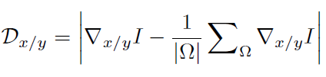
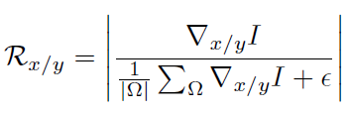
Local Variation Deviation(LVD)
The local variation represents the gradient feature and its deviation represents the variation correlation in the local patch. Therefore, local variation deviation provides surprisingly strong discriminative power in distinguishing texture (weak correlation) and structure (strong correlation).
absolute deviation
rewritten
relative deviation

Slide 15
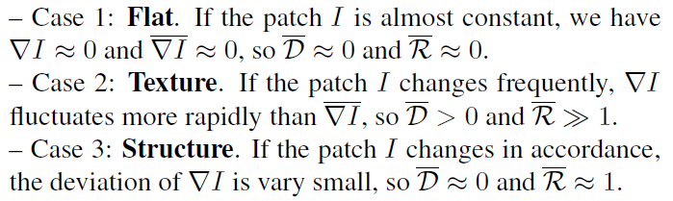
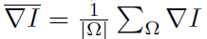
LVD Analysis

Slide 16
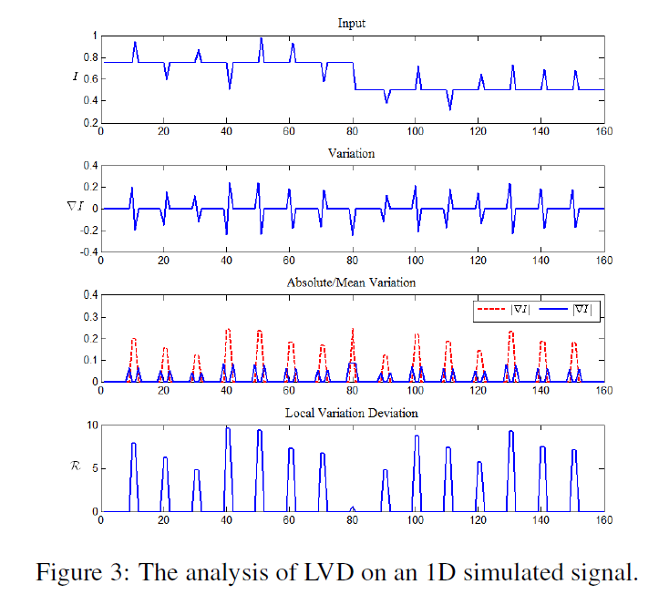
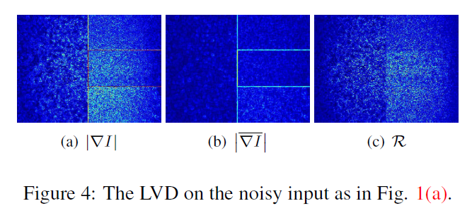
Quantitativelly Analyze the Effectiveness of the LVD
Notes:
1D signal contains both texture and structure.
the absolute variation |∇I| contains full gradients including textures and structures;
The mean variation ∇I only contains obvious structures;
the local mean filter inhibits the textural response, so the texture produces smaller values of ∇I than |∇I|

Slide 17
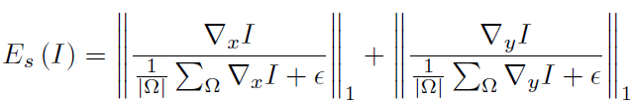
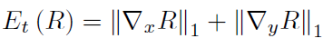
Intrinsic Prior——Shape & Texture
Shape prior
(LVD)
Texture prior

Slide 18
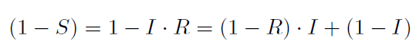

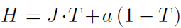
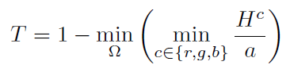
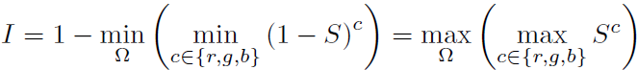
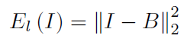
Extrinsic Prior on Illumination
H is the observed hazy image
J is the real scene to be recovered
T is the medium transmission
S = I ・R
a is the global atmospheric light
A dark channel prior
bright channel prior

Slide 19

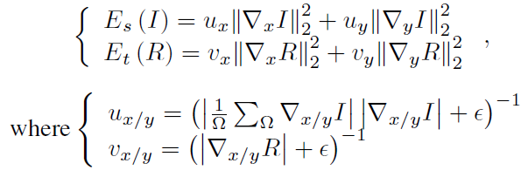
Joint Optimization

Slide 20
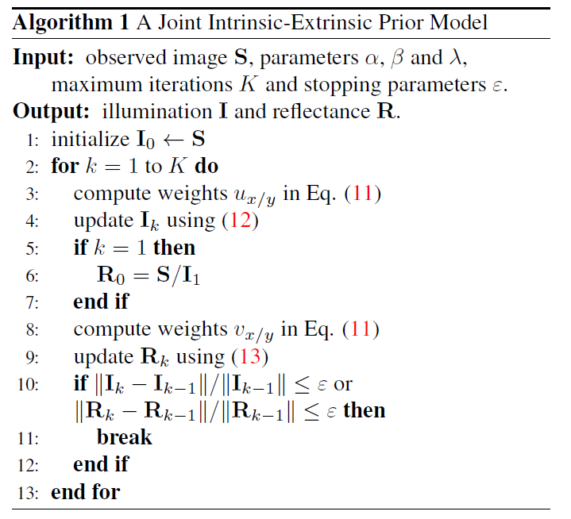
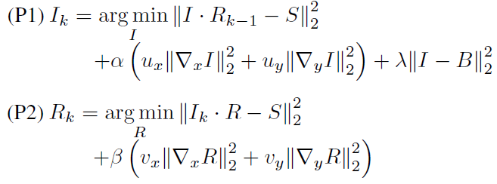
Implement Algorithm

Slide 21
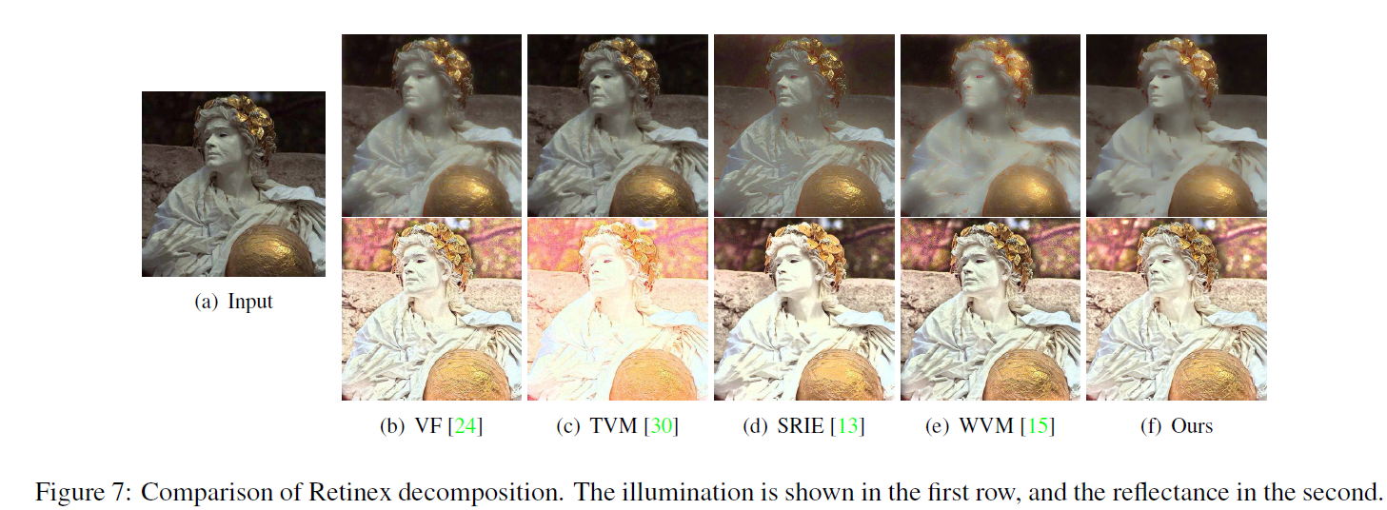
Experiments —— Retinex Decomposition

Slide 22
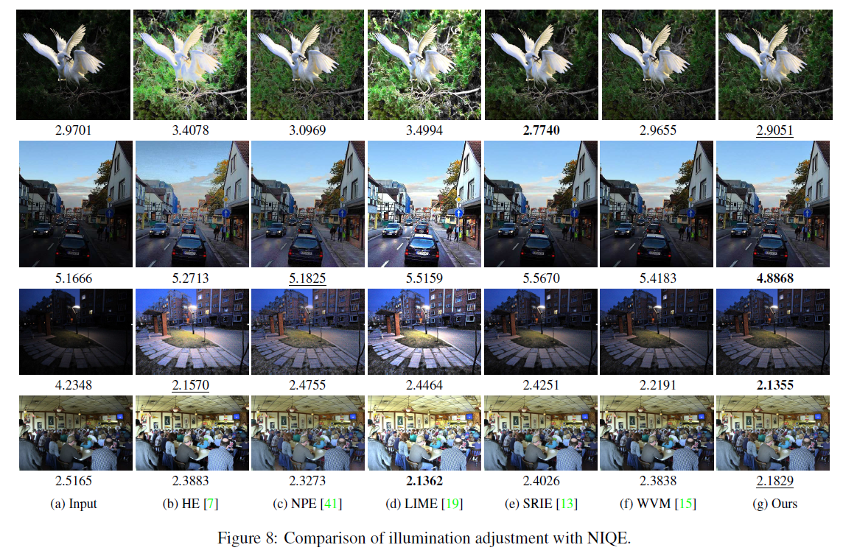
Experiments —— Illumination Adjustment

Slide 23
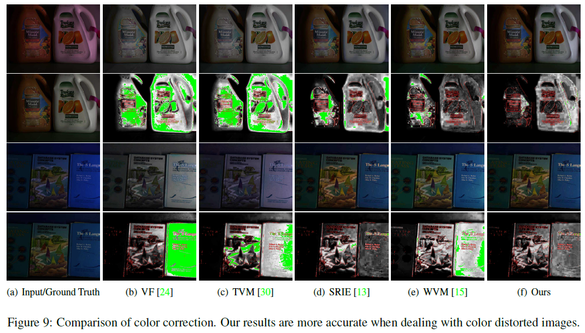
Experiments —— Color Correction

Slide 24
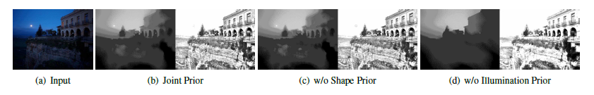
Experiments —— Prior Impact

Slide 25
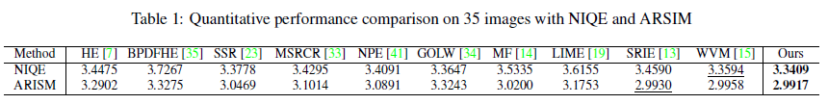

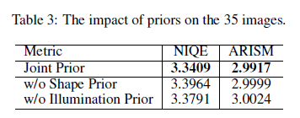
Experiments Tables

Slide 26
3. Some Results on BOLD datasets and MIT datasets

Slide 27
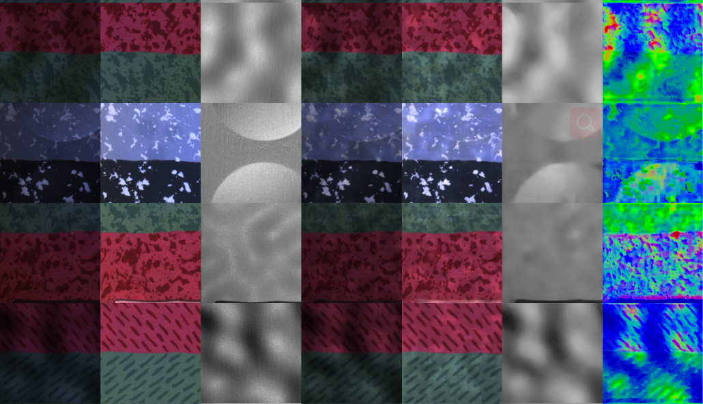
Experiments—one
Base model: RIN
Reflectance loss：MSE and Cos shading loss：MSE and Cos

Slide 28
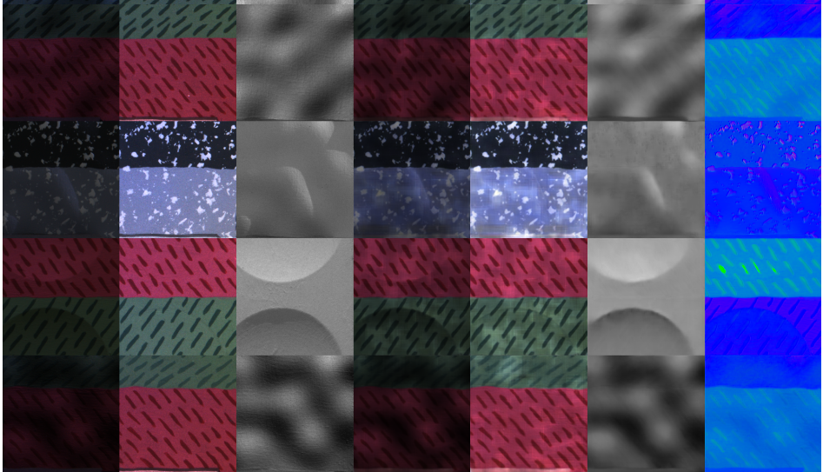
Experiments—two
Base model: RIN
Reflectance loss：MSE and Cos shading loss：MSE and Cos shape loss：Cos

Slide 29
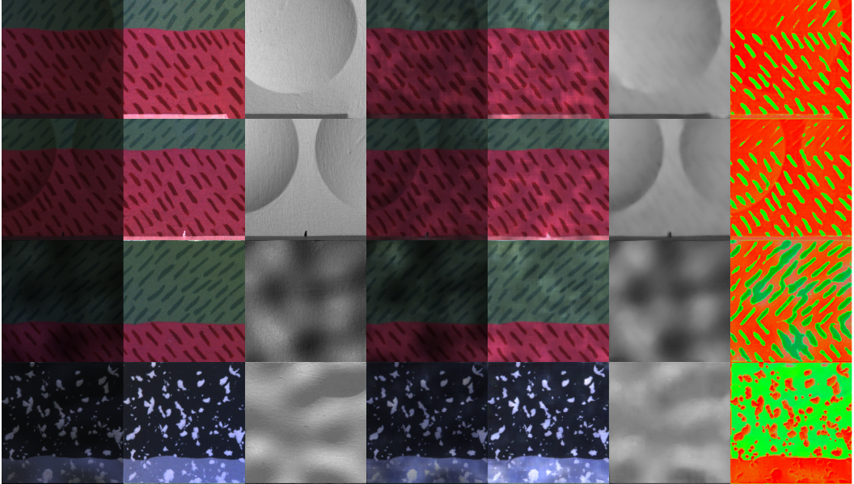
Experiments—three
Base model: RIN
Reflectance loss：MSE and Cos shading loss：MSE
shape loss：Cos

Slide 30
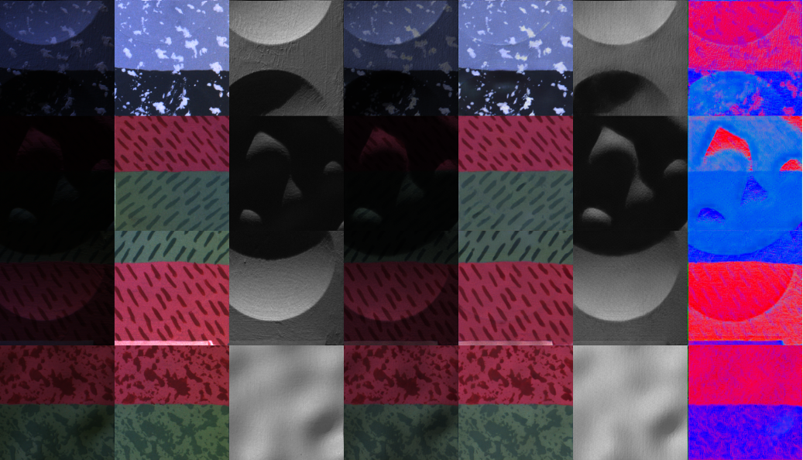
Experiments—four
Base model: RIN
Reflectance loss：Cos, BF, VGG shading loss: BF, VGG
shape loss：Cos

Slide 31
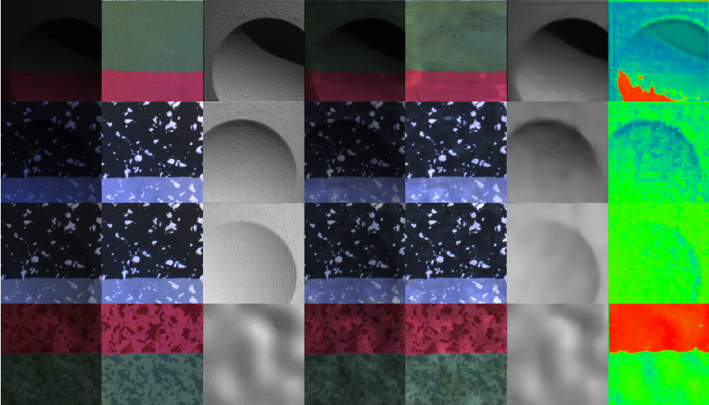
Experiments—five
Base model: RIN
Reflectance loss：Cos, BF shading loss: BF
shape loss：Cos

Slide 32
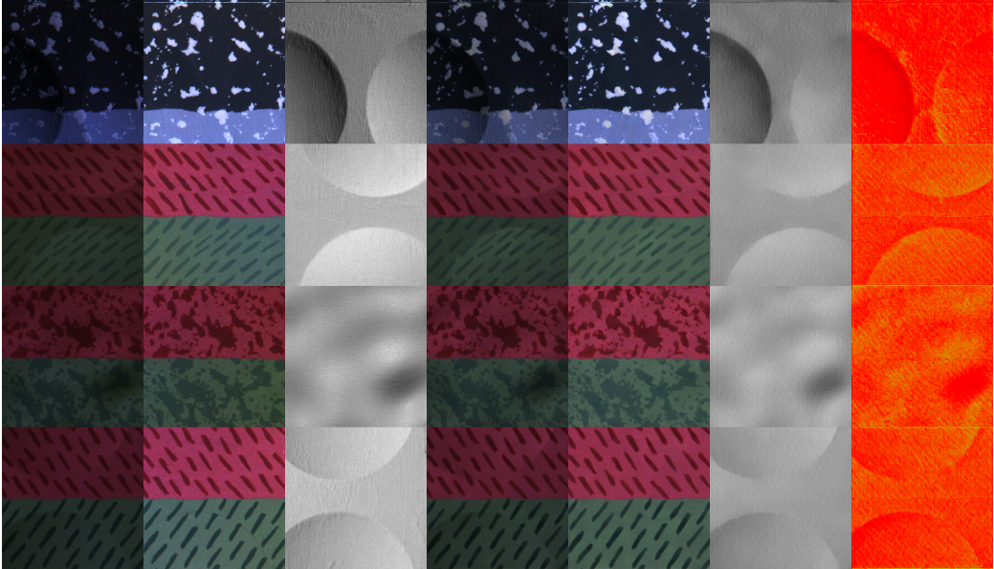
Experiments—six
Base model: RIN
Reflectance loss：Cos, VGG shading loss: VGG
shape loss：Cos

Slide 33
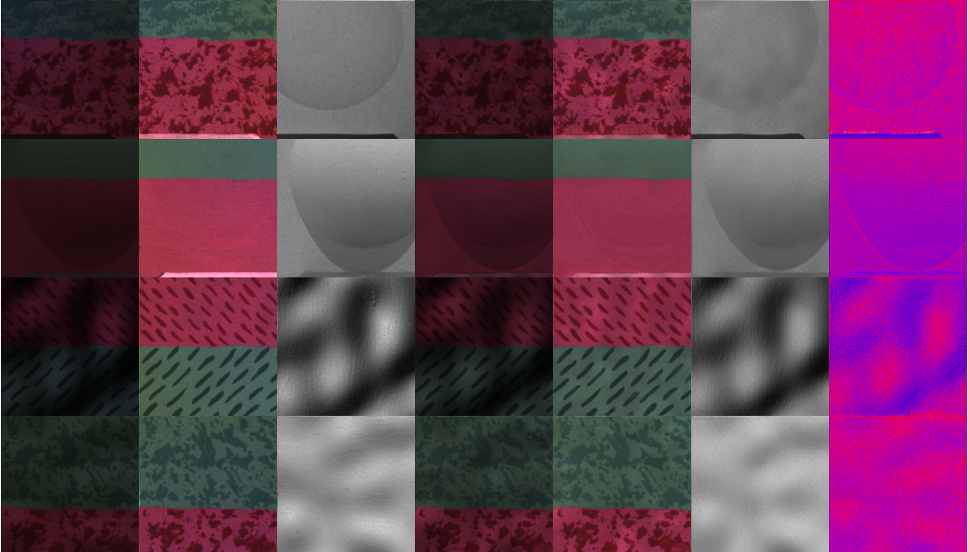
Experiments—seven
Base model: RIN
Reflectance loss：Cos, BF, VGG(0.1) shading loss: BF, VGG(0.1)
shape loss：Cos

Slide 34
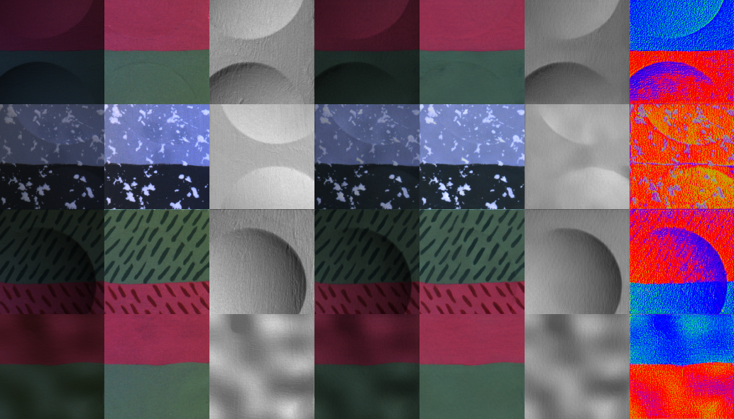
Experiments—eight
Base model: RIN
Reflectance loss：Cos, BF, VGG(0.05) shading loss: MSE, BF, VGG(0.05)
shape loss：Cos

Slide 35
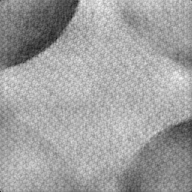
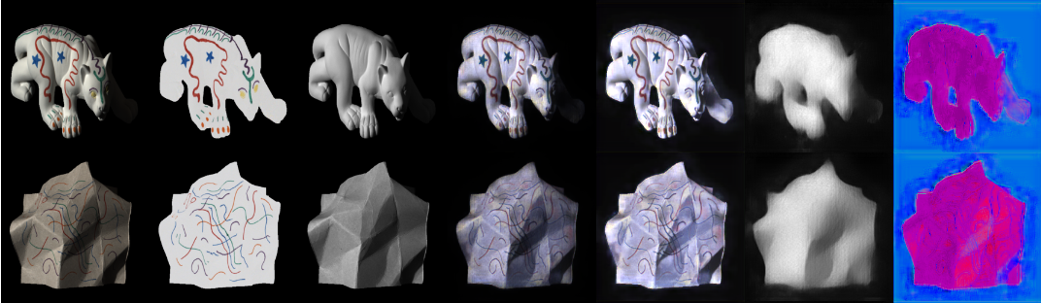
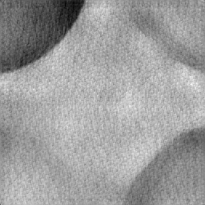
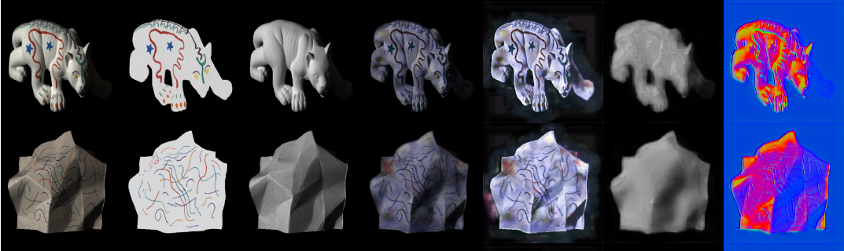
Existing problems
Shading problem Poor generalization problem
COS,
VGG
And
BF
COS,
VGG
And
BF
COS,
VGG(0.05),
BF
And
MSE
MSE
And
COS

Slide 36
Conclusion
Cos loss and BF loss can slightly enhance shading edges.
VGG loss can greatly enhance reflectance with no negative effects, but cause unknown noise when greatly enhancing shading edges.
RIN model trained on BOLD datasets generalize poorly in MIT datasets. The possible reason is the two datasets are in different distributions, especially colors and details of textures, etc.

Slide 37
Future work
Remove some activations in VGG features;
Jointly train multi-datasets(BOLD and ShapeNet)
Change network architecture (R2U-Net, Attention U-Net, Attention R2U-Net, etc.)

